Slide 1
Chapter: 6.8
Practical applications

Slide 2
The practical applications of water is depend on its high surface tension and ability to act as a solvent.
Surfactants: polar & non-polar
Non-polar liquids do not mix with polar solvents. These substances are known as immiscible substances. The tension between water and oil can be reduced by adding a surfactant. They appear to dissolve in each other and there will be the formation of an emulsion. This is a mixture of two immiscible substances.

Slide 3
The compound that helps form the emulsion is called an emulsifier.
E.g. Eggs are a good emulsifier for oil & vinegar.
The resultant emulsion is called as mayonnaise.
Milk is considered to be an ‘oil in water’ emulsion. When whipped sufficiently, turns into a ‘water in oil’ emulsion, called butter. Excess water will be separated in the process.

Slide 4
Detergents: surfactants that clean
Examples of surfactants- Soaps & detergents. One end of surfactant is hydrophilic and the other end is hydrophobic.
Soap forms micelles, sub-microscopic clusters in water, which have polar ends on the outside and hydrophobic tails in the middle where they can avoid water.
The long tail of soap dissolves into grease because of dispersion forces.

Slide 5
There is an ion-dipole interaction between the polar head and the water molecules. More and more hydrophobic tails of the soap molecules will tunnel into the grease droplet, eventually incorporating into the water.

Slide 6
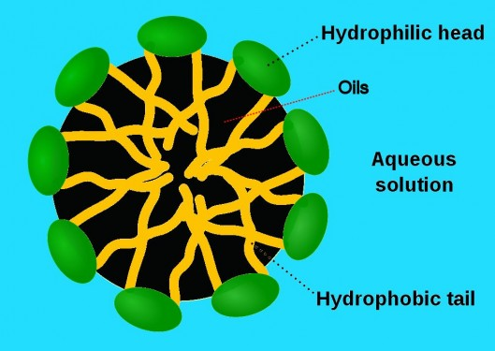

Slide 7
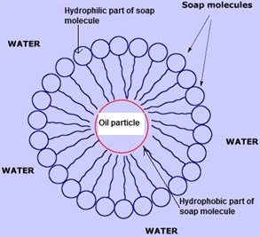

Slide 8
Surface tension of water can be reduced by dissolving surfactants such as soap or detergent. The surfactant breaks the hydrogen bonding between the molecules and the water spreads out onto the surface rather than remaining in a droplet.
See diagram C6.29 page: 287 NC

Slide 9
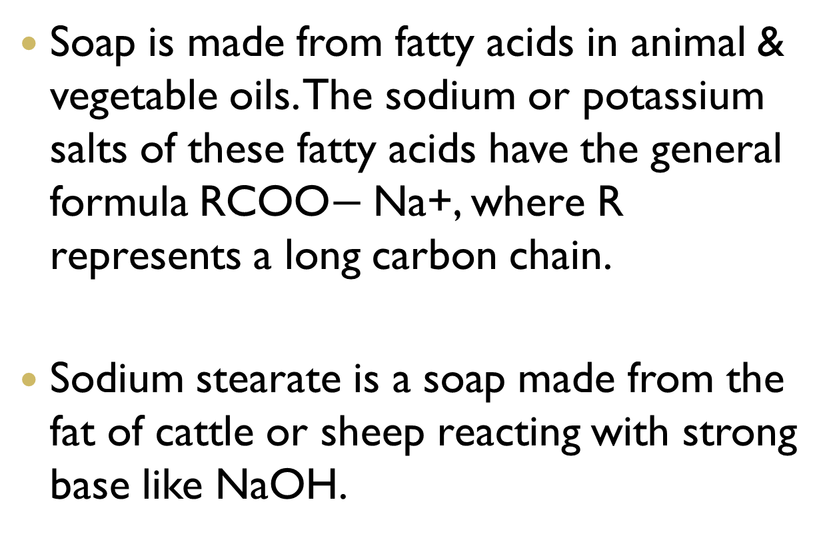
Soap is made from fatty acids in animal & vegetable oils. The sodium or potassium salts of these fatty acids have the general formula RCOO$−$Na+, where R represents a long carbon chain.
Sodium stearate is a soap made from the fat of cattle or sheep reacting with strong base like NaOH.

Slide 10
Saponification reaction
C17 H33COOH + NaOH  R-COONa+
Fatty acid (oleic acid) Base soap
+R’ OH
Alcohol
The soap formed has a polar head (COONa+)
And a non-polar hydrocarbon tail(R). The polar head is strongly attracted to water molecules and long tail is hydrophobic.

Slide 11
The tail will dissolve into grease or oil.
Detergents are used in hard water rather than soap, which does not form a lather.
Detergents have an ionic head based upon sulfate ions. These sulfate ions do not precipitate the calcium or magnesium ions in hard water as soap does.

Slide 12
Classification of detergents
Based on the charge on their polar head they can be classified.
Anionic detergents---- have a negatively charged sulfate ion
Cationic detergents----- have a positively charged end
Non-ionic detergents----- do not have any ionic groups.

Slide 13
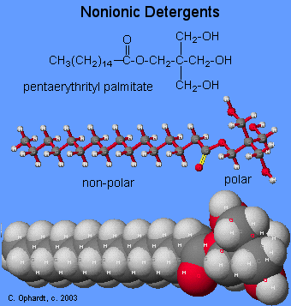

Slide 14
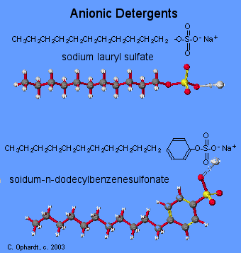

Slide 15
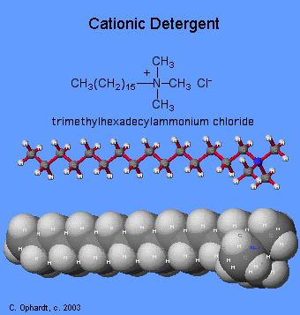

Slide 16
Surfactants like detergents interrupt the surface tension of water. Surfactants have both polar & non-polar regions.

